Slide 1
CROWD MANAGEMENT SOLUTION FOR EVENTS
INTERNAL GUIDE: JASMIN M R
EXTERNAL GUIDE: JOBY CLAMEEZ
PRESENTED BY,
AMAL BHAS P
BLESSY P ROY
SREELEKSHMI PRATHAPAN
(GROUP-8)

Slide 2
OVERVIEW
ABSTRACT
EXISTING AND PROPOSED SYSTEM
MODULE DESCRIPTION
USE CASE DIAGRAM
TECHNOLOGIES USED
REFERENCES

Slide 3
ABSTRACT
App to enable social distancing at Shops, religious places and events . Organizer (Shops, religious places and events )Should be able to set location, capacity and set virtual Queue system. User - Book slots, entry and exit Automatics entry & exit, Queue clearance and notifications, Location management Mobile app and cloud service.

Slide 4
Existing System
01
Cities are growing at a dizzying place and they require improved methods to manage crowded areas.
02
Crowd management stands for the decisions and actions taken to supervise and control densely populated spaces and it involves multiple challenges
03
From recognition and assessment to application of actions tailored to the current situation.

Slide 5
Proposed System
Modern technology aims not only to make people’s life easier but also more safely.
Being in a highly crowded place like stadium, metro stations or holy places on Hajj affects not only the human level of comfort but mainly the human level of safety.
The current work introduced a mobile based crowd management system.
Proposed System is the app to enable social distancing at Shops, religious places and events .Organizer religious should be able to set location, capacity and set virtual Queue system.

Slide 6
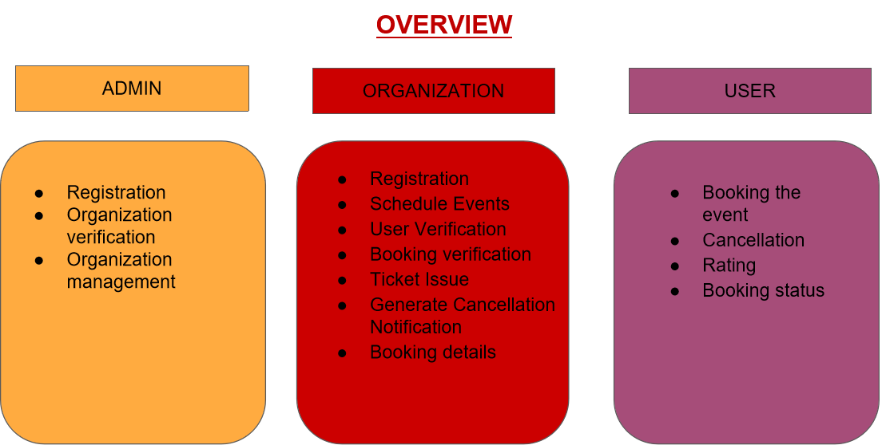

Slide 7
Modules
ADMIN
Admin is the authority who has the responsibility to manage the crowd in order to maintain the social distance in different Organizational Events.
Functions of Admin
Organization Verification : Admin can approve or reject the registered Organization.
Organization Management: Control the Event conducted by the Organization
Event Approval
Event Reject

Slide 8
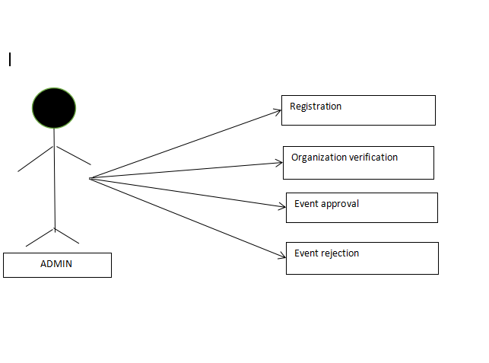
USE CASE DIAGRAM (ADMIN)

Slide 9
ORGANIZATION
Organizations conduct all those public events such as medical camps,worships,private party,political party events all those mass gatherings.
Functions of Organization
Registration : Organization can Register.
Schedule Events : Declare the event and time to the user and the maximum number of slots.
User Verification: Approve or Reject the registered user.
Booking verification:View Booking Details of users and they can verify and approve.
Ticket Issue:Ticket is issued for approved booking.
Generate Cancellation Notification :Notification sent to other users if any user cancelled the booked event.
Booking details:A view of Event booking details of users.

Slide 10
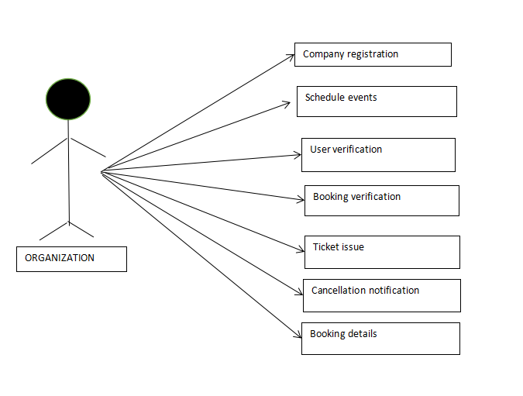
USE CASE DIAGRAM (ORGANIZATION)

Slide 11
USER
Person Or Group of Person who need to participate in an Event which is held by the
Organization.User need to complete the registration process and can do further function.
Functions of User
Registration:user can register
Booking :Book the event slot.
Booking status:View the booking status of the event.
Rating:Users can rate the Organization according to its performance.
Cancel:Cancel the booked event.

Slide 12
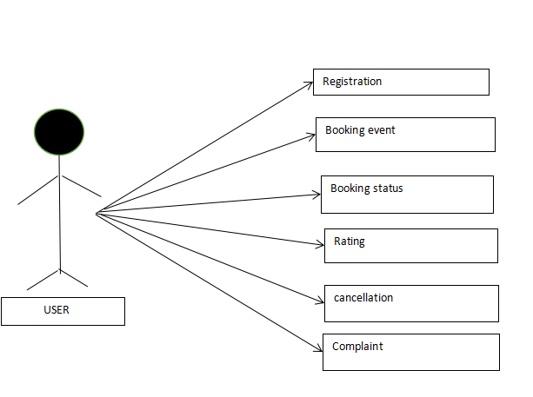
USE CASE DIAGRAM (USER)

Slide 13
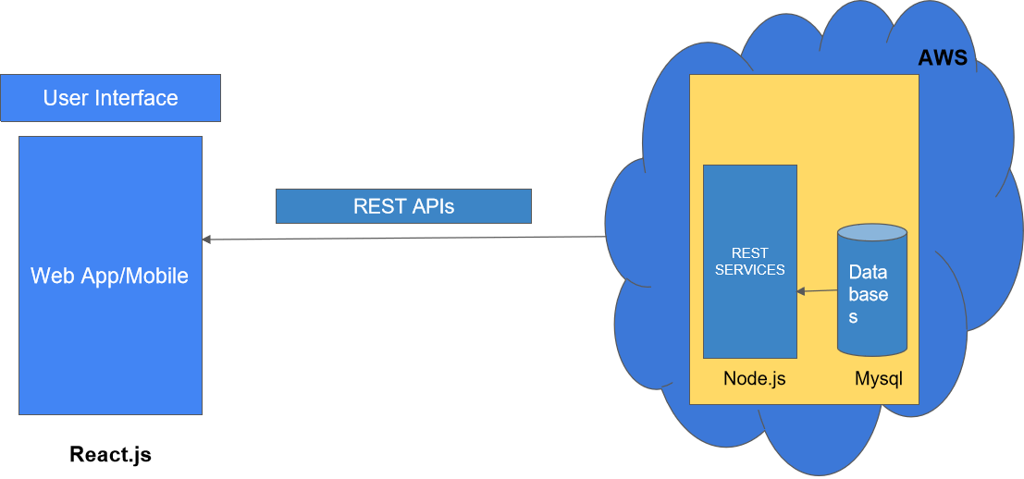

Slide 14
Technologies used:
Node.js
Node.js is an open source server environment.
It uses JavaScript on the server.
It is used to develop I/O intensive web applications like video streaming sites, single-page applications, and other web applications.
Node.js is open source, completely free, and used by thousands of developers around the world.

Slide 15
RESTFul web services
A web service is a collection of open protocols and standards used for exchanging data between applications or systems.
Web services based on REST Architecture are known as RESTful web services. These web services use HTTP methods to implement the concept of REST architecture.
A RESTful web service usually defines a URI, Uniform Resource Identifier a service, provides resource representation such as JSON and a set of HTTP Methods.

Slide 16
MySQL
MySQL is a relational database management system based on the Structured Query Language, which is the popular language for accessing and managing the records in the database. MySQL is open-source and free software under the GNU license. It is supported by Oracle Company.
It allows us to implement database operations on tables, rows, columns, and indexes.
It defines the database relationship in the form of tables (collection of rows and columns), also known as relations.
It provides the Referential Integrity between rows or columns of various tables.
It allows us to updates the table indexes automatically.
It uses many SQL queries and combines useful information from multiple tables for the end-users.

Slide 17
Amazon Web Services (AWS)
AWS is a highly available, secure cloud services platform that offers more than 100 cloud applications.
It helps in controlling, auditing, and managing identity, configuration, and usage.
It allows users to select the operating systems, language, database, and other services as per their requirements.
AWS provides a secure and durable platform that provides end-to-end security and storage.

Slide 18
References
https://www.udemy.com/share/104y4S3@wYymVIIKvciCuJTXYibBKQpSubnOhcMmhDCA_E1mc_71Ma83DW3-MpqnFmIWf4xF/
https://www.researchgate.net/publication/318058287_A_Mobile_Based_Crowd_Management_System
https://www.mdpi.com/2071-1050/14/1/303/pdf

Slide 19

THANK YOU………!

